Slide 1
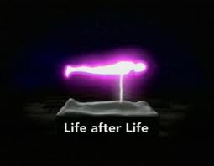
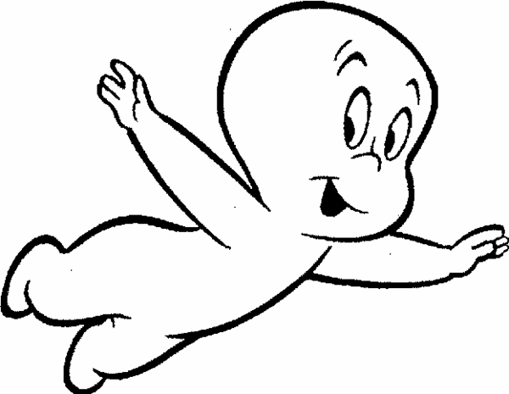
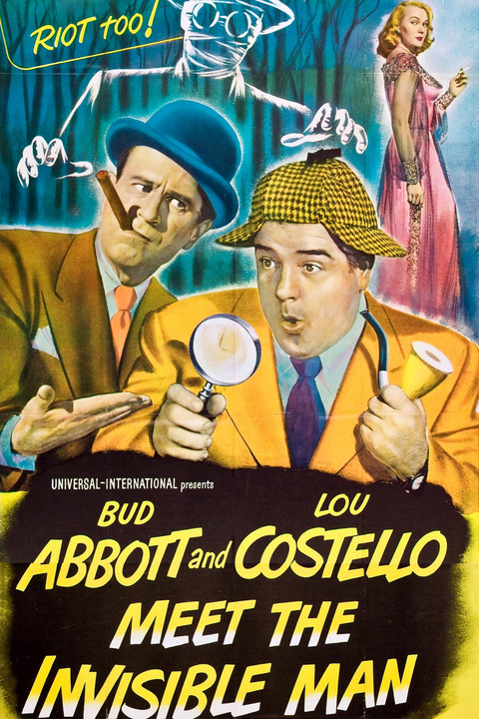
No Box?
You gotta be kidding me.

Slide 2
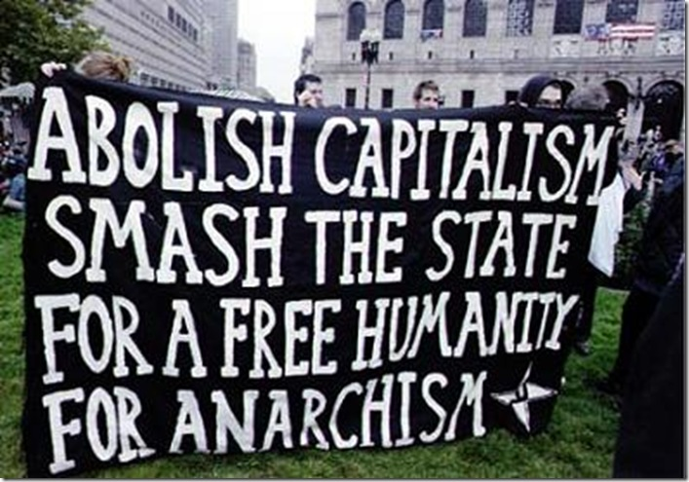
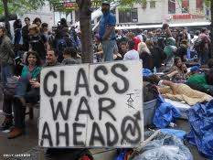

The box we face right now is
racist capitalist democracy
No box would mean no racism,
no objective class relations,
no limitations on freedom.

Slide 3
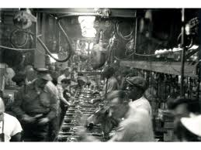
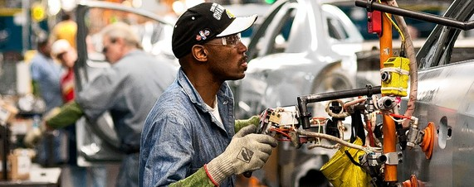
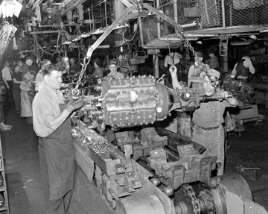
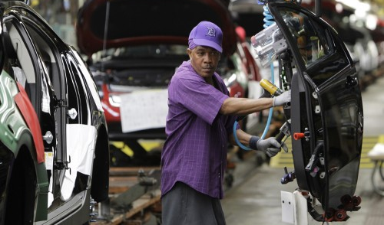
Industrial society

Slide 4
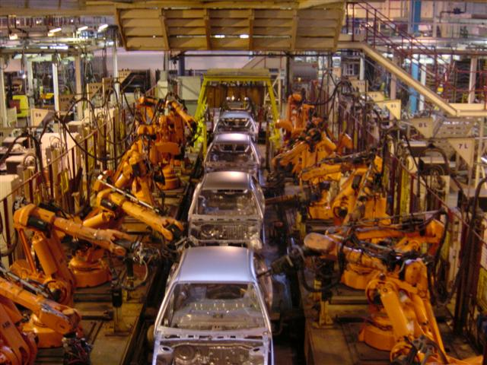
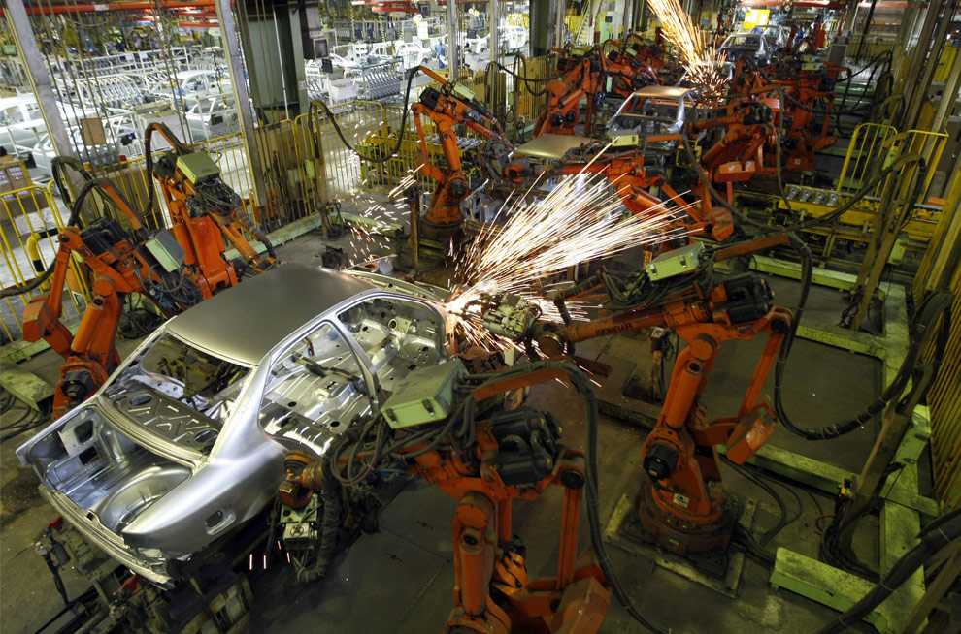
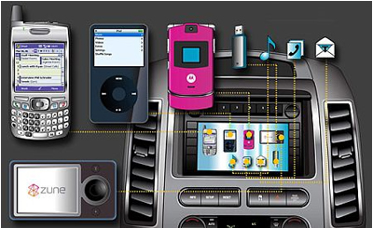

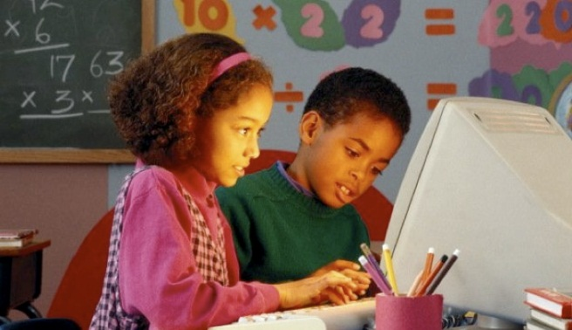
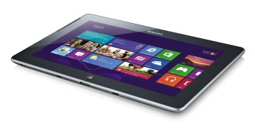
Informational society

Slide 5
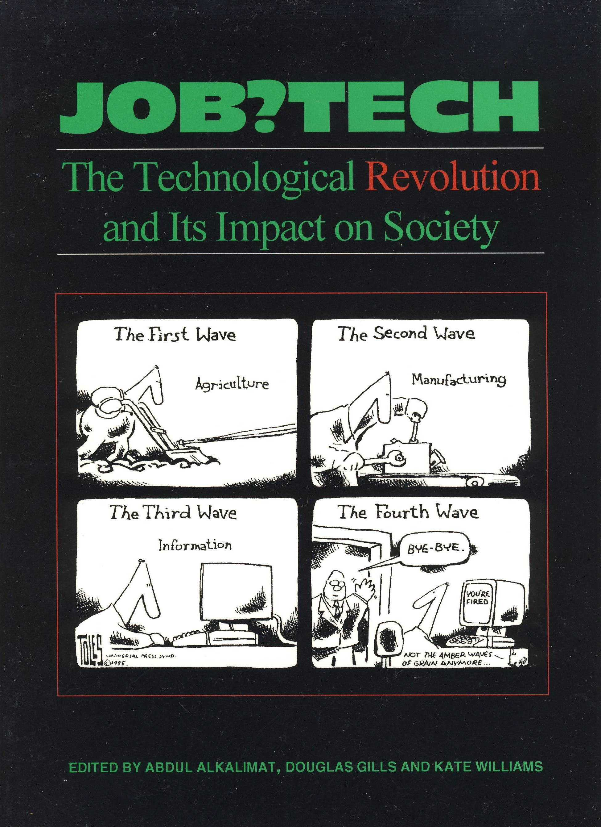
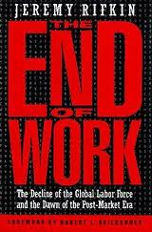
Change is necessary

Slide 6
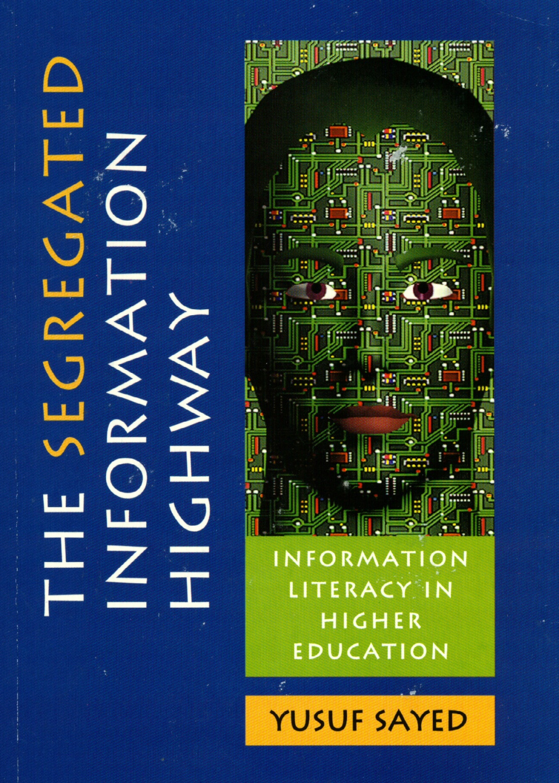
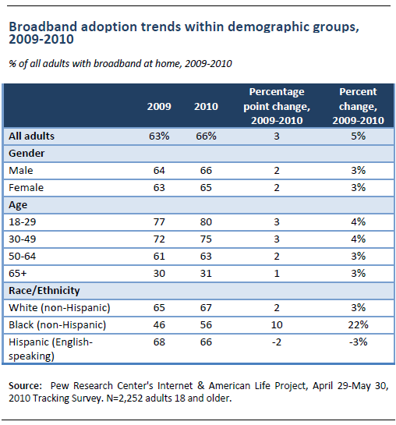
Black people use cell phones,
but can you fill out a job
application or write a term
paper on your phone? Can
we leap over the digital divide?

Slide 7
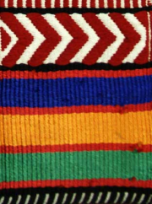
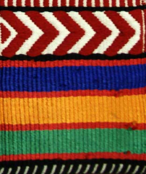
Technology and Black history

Slide 8
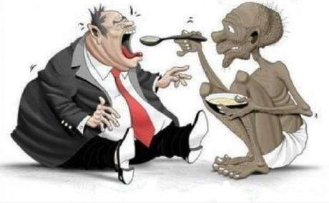
What remains?
1% vs 99%

Slide 9
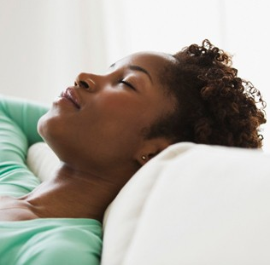
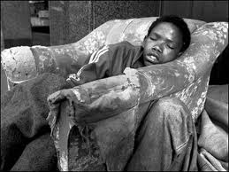
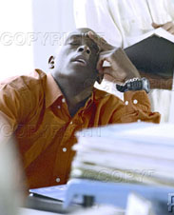
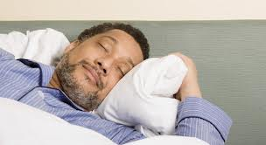
Black People
dream about
NO
BOX
What is the meaning of living in a free society?

Slide 10
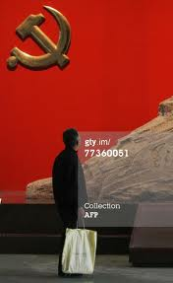
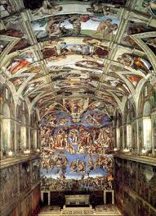
No Box is a utopian vision.
Utopia (/juːˈtoʊpiə/) is an ideal community or society
possessing highly desirable or perfect qualities.
Heaven
Communism
Cyberspace
Humans become gods

Slide 11
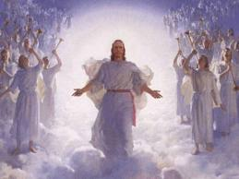
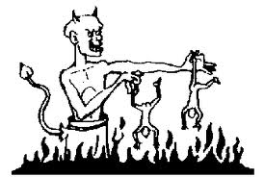
Heaven
Basic assumptions:
There is an after life
The future is either all
negative or all positive
Some allow for an in
between state
This requires a leap of faith,
hence on faith, multiple religions have equal legitimacy.
The main question remains, what does heaven have to do with right here and now?
Hell
(Maybe its how I act right now?)

Slide 12
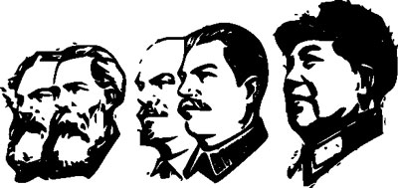
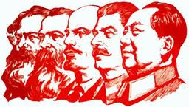
Classless society
Will the box of class exploitation
ever end once and for all? Not so far.

Slide 13
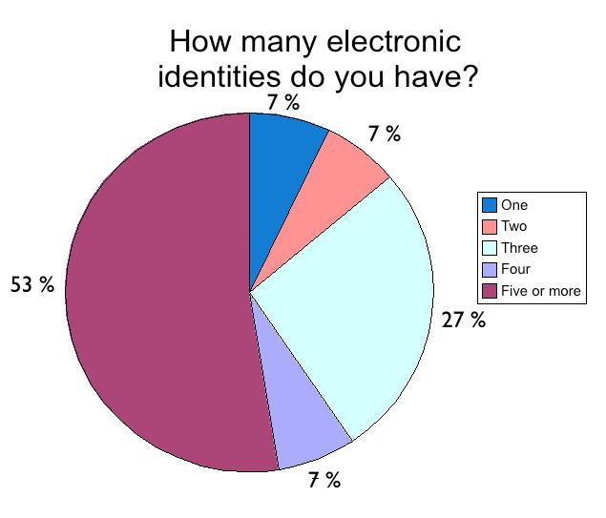
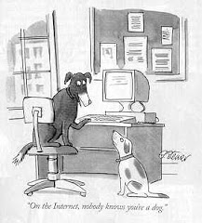
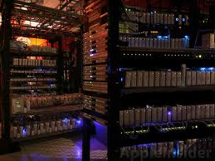
Cyberspace
The real question is where do the servers live. If you own the servers you own cyberspace, the cloud.

Slide 14
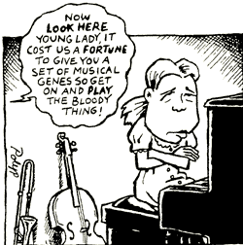
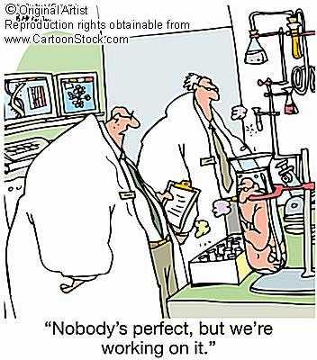





Men/women are not gods

Slide 15
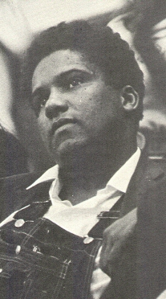

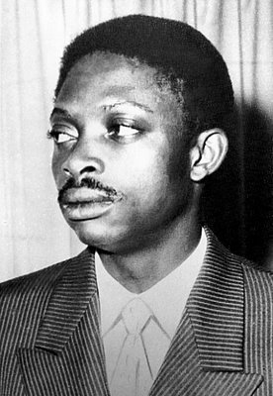
But, utopian visions and beliefs
fuel the revolutionary process
Of course, we’re fighting for a future that has never been, but must be our goal!

Slide 16
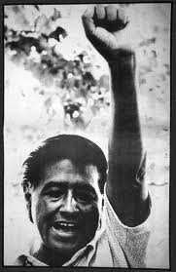
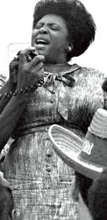
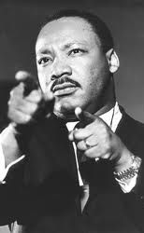
And other dreamers as well…

Slide 17
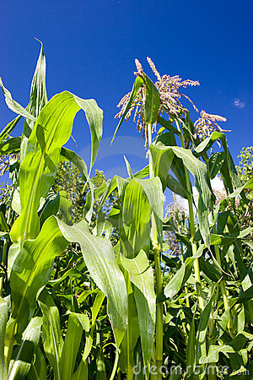
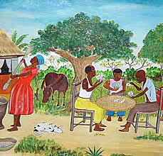
Matter matters
In other words no matter what we think about
what is, reality will show up like it does when
you fall off a bike and hit the ground. So, there
are two realities that face everybody 24/7:
Nature
Society
The hardest thing to remember is that we are part of nature.

Slide 18

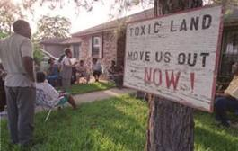
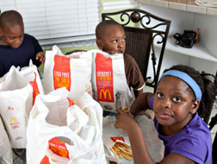
Nature
Environment
Health
Sustainability

Slide 19
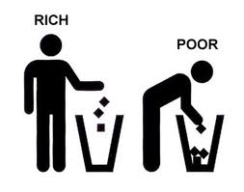
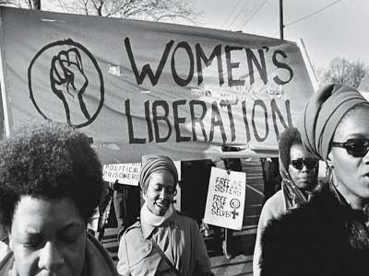
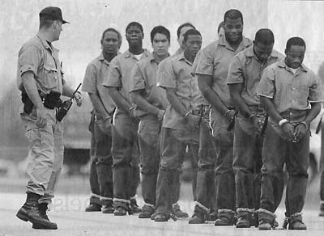
Society
Class polarity
Human rights
Gender equality

Slide 20
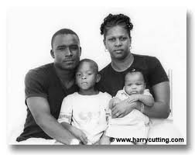
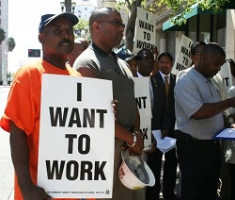



But we cant deal with the fundamental boxes of
nature and society like we were Casper the ghost.
We have to deal with the reality of life as we live
it on a daily basis.

Slide 21
Our rethinking the BLM has
to be summarized and given
a final direction, a direction
for study and a direction
for struggle. The best we can
do will be in the last lecture.
BLM = Black Liberation Movement

